Slide 1






Accelerating the Ocean Enterprise
Presented by:
+ Hans Van Sumeren, Senior Director, Ocean Enterprise Initiative, Marine Technology Society (MTS)
+ Caisey Hoffman, Manager, Ocean Enterprise Initiative, Marine Technology Society (MTS)
+ Peer Fietzek, Senior Business Development Manager Ocean Science, Kongsberg Discovery
+ Patrick Gorringe, Global Ocean Observing System (GOOS)
oceanenterprise.com

Slide 2
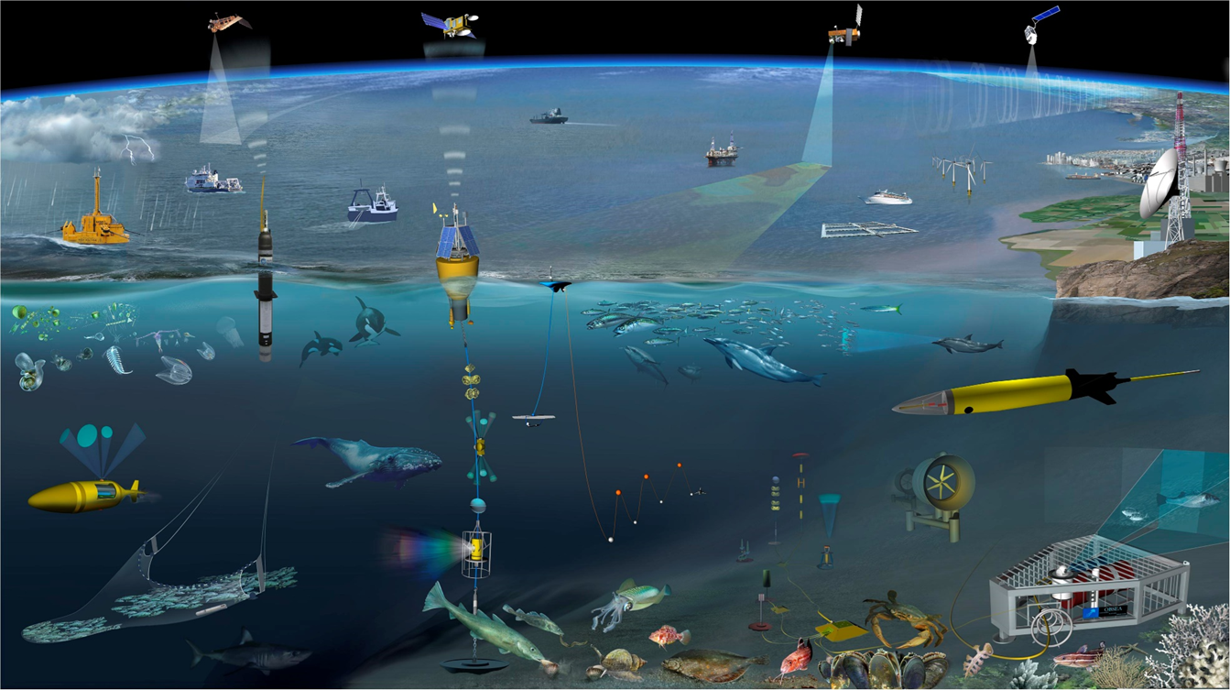

What is the Ocean Enterprise?
All entities in the public, private, non-profit, research and academic sectors that provide infrastructure and capacity of ocean observations, measurement, and forecasting, or who deliver operational ocean information projects and services.
(source: Glynn Gorick and the NeXOS project)

Slide 3
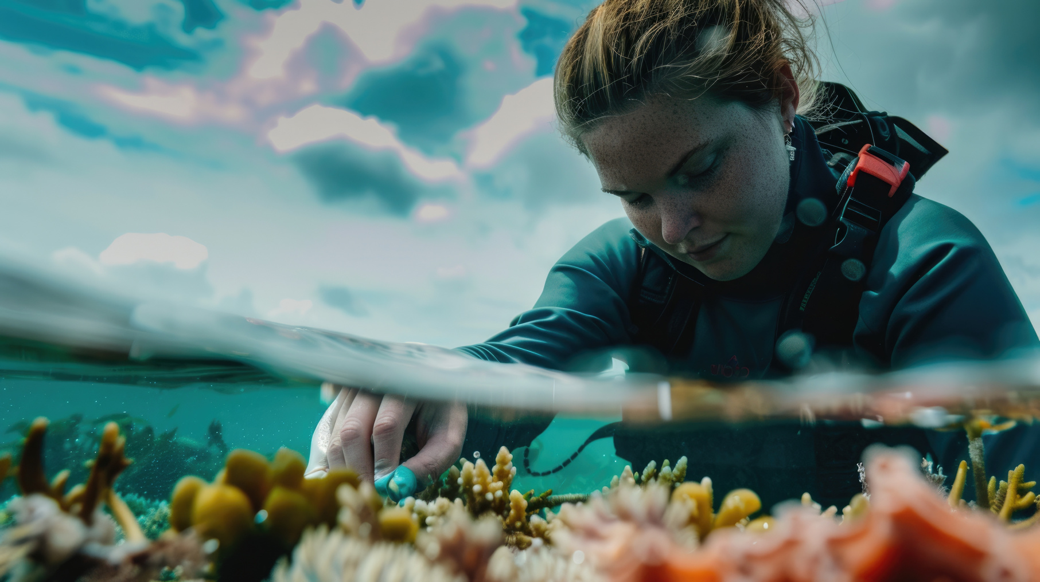
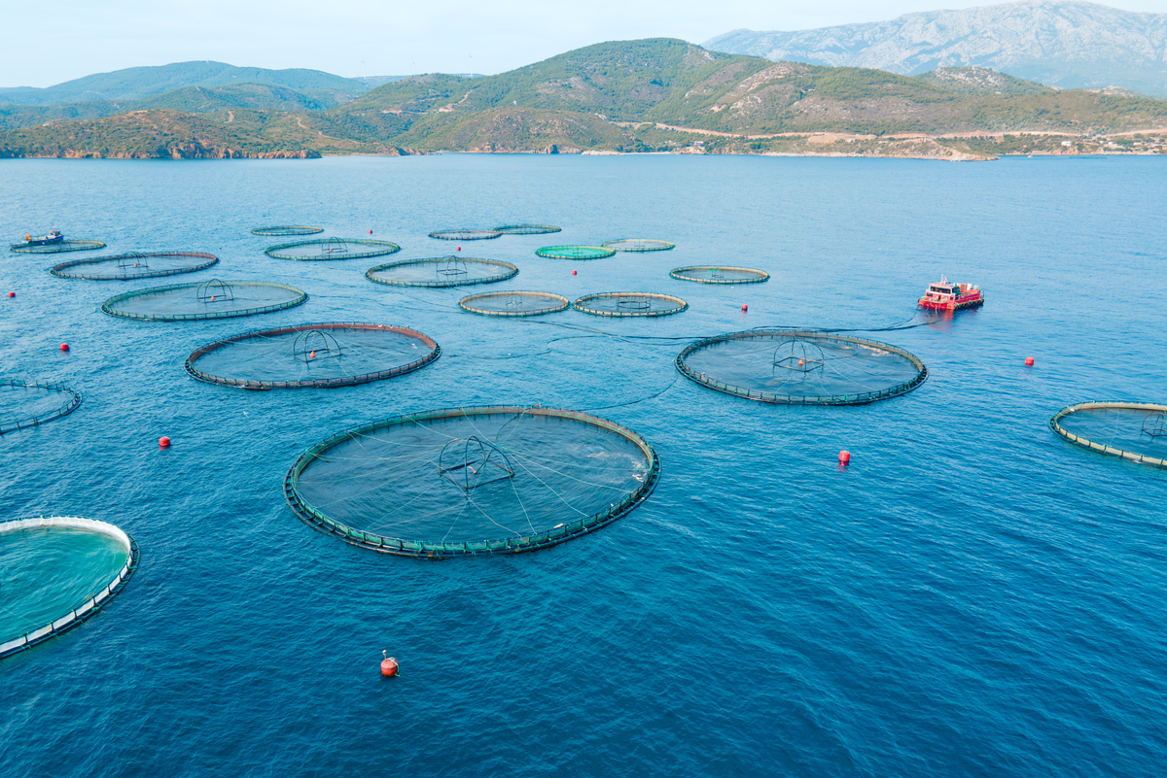
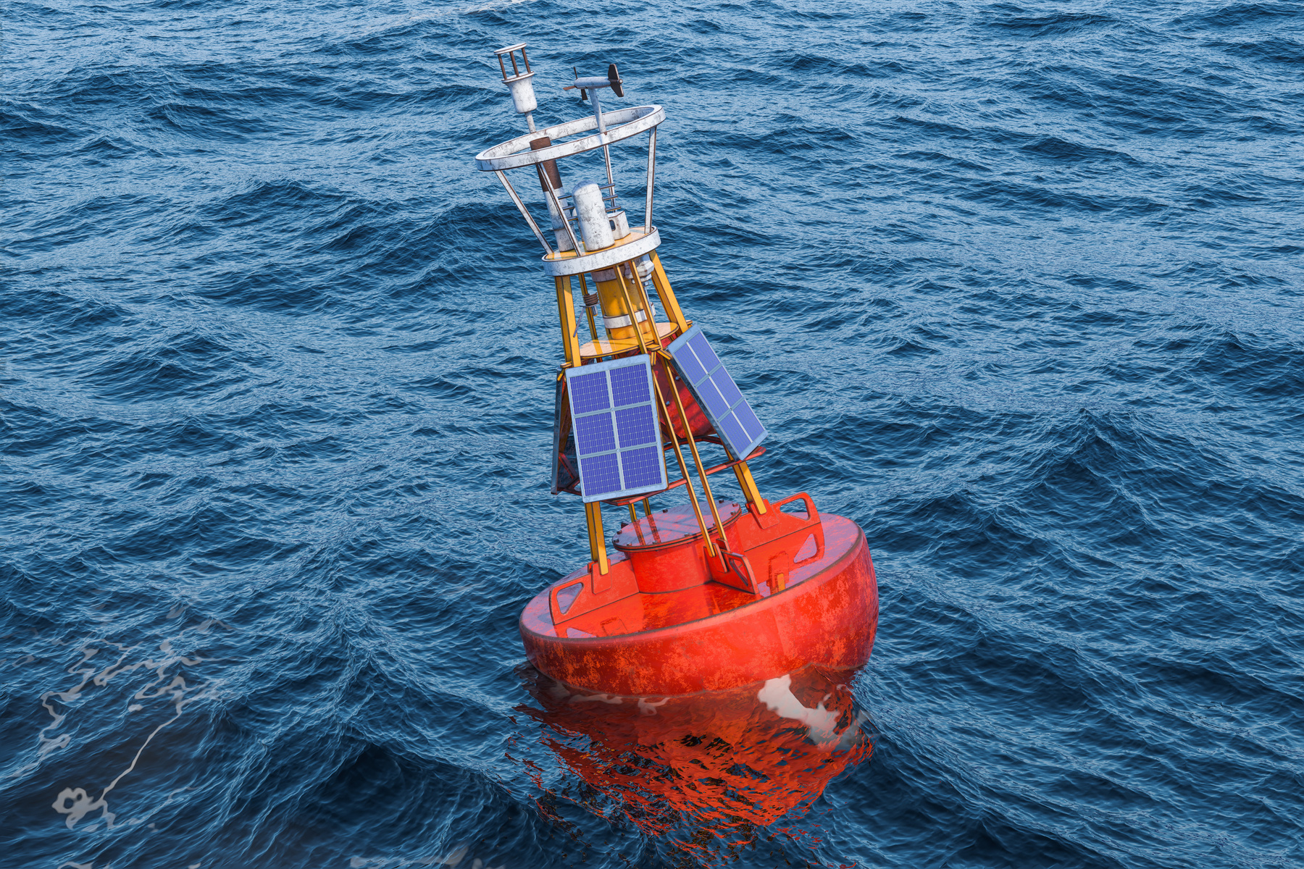
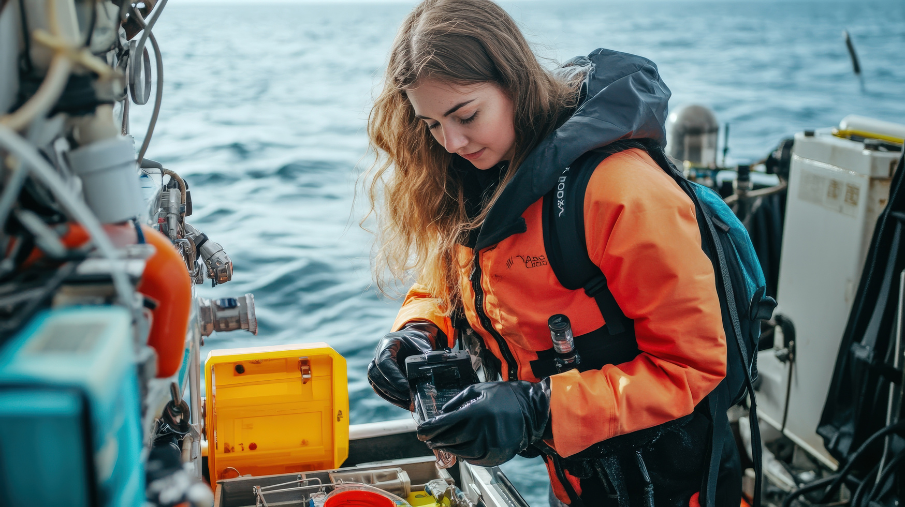
What is the Ocean Enterprise Initiative?
+ A flagship program to help create the environment for growth through greater dialogue and collaboration
+ The Ocean Enterprise Initiative is the expansion of the signature program Dialogues with Industry, launched in 2022 with partners from GOOS, NOAA, and industry partners Kongsberg Discovery and L3Harris.

Slide 4
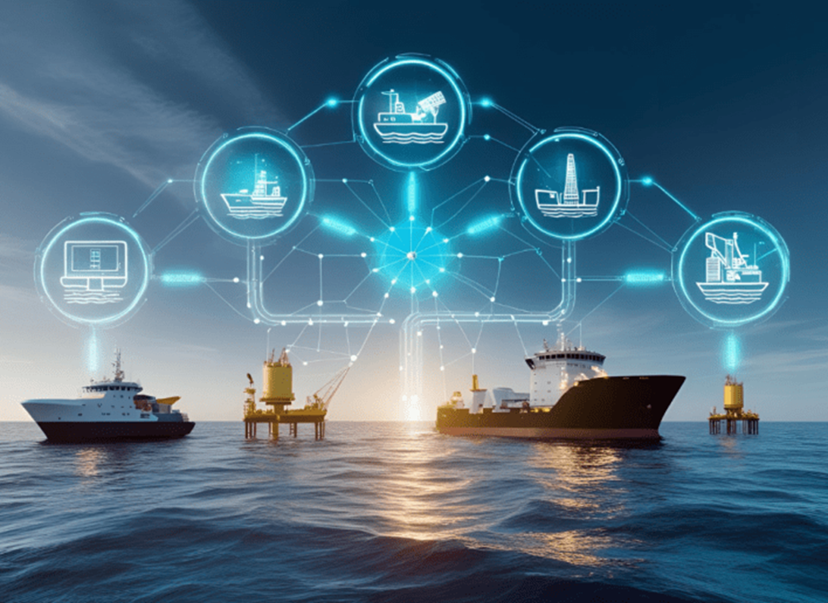
Vision Statement
A flourishing Ocean Enterprise that is recognized as an integral market sector, grows a sustained ocean observing system, and changes the perception of ocean information from peripheral to essential to society.
Mission Statement
Grow the ocean observing system through better public-private partnerships by creating a globally inclusive forum to understand market opportunities, incentivize ocean solution innovation, facilitate data and information exchange, develop a workforce, and proliferate scalable technology to achieve benefits for all stakeholders of the Ocean Enterprise.

Slide 5
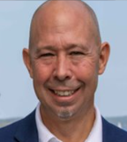
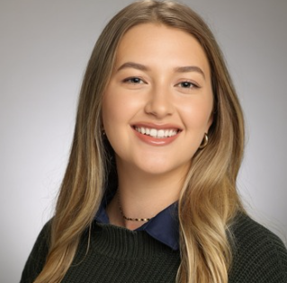
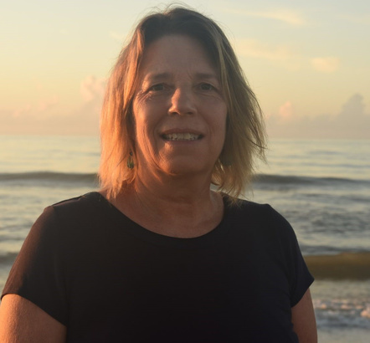
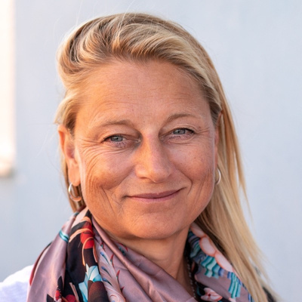

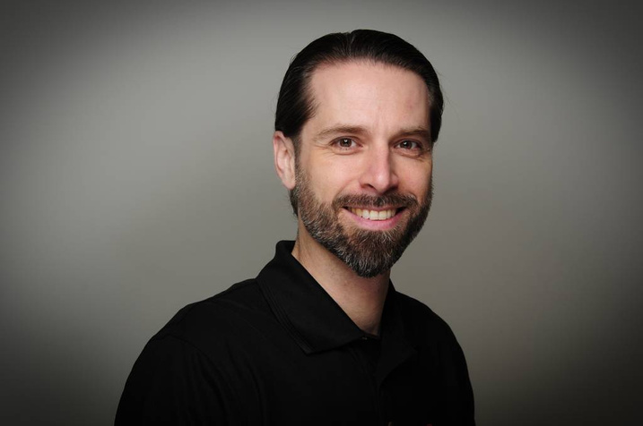
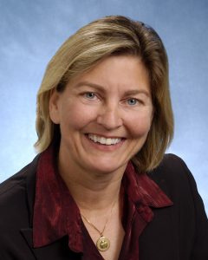
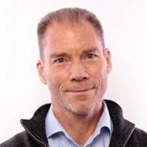
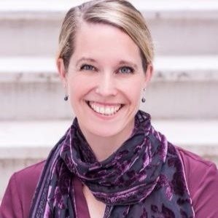
Executive Team
Hans Van Sumeren
Caisey Hoffman
Zdenka Willis
Emma Heslop
Zack Baize
Senior Director, Ocean Enterprise Initiative
Manager, Ocean Enterprise Initiative
CEO Veraison Consulting
Past President MTS
Program Specialist,
Global Ocean Observing System (GOOS), IOC/UNESCO
Program Manager,
NOAA Blue Economy Program
Peer Fietzek
Donna Kocak
Patrick Gorringe
Jessica Snowden
Senior Business Development Manager Ocean Science, Kongsberg Discovery
Fellow, Senior Scientist Innovation Strategy Lead, L3Harris
Manager International Ocean Relations, SMHI
Deputy Director,
Global Ocean Monitoring & Observing, NOAA/OAR

Slide 6
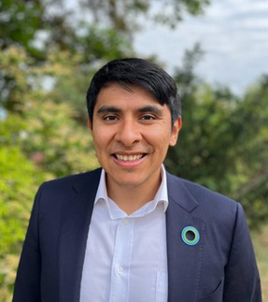
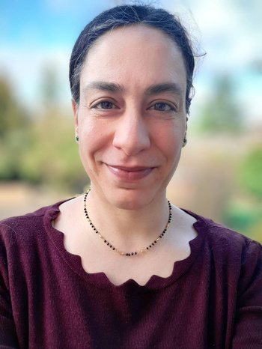
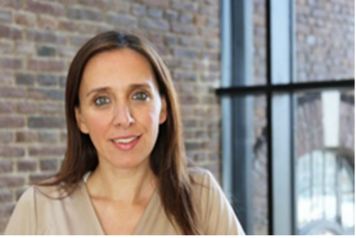
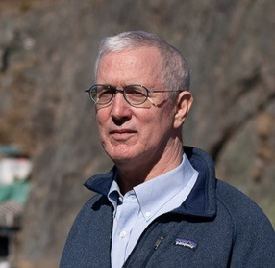
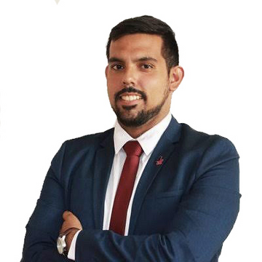
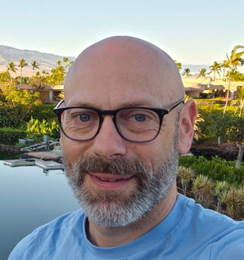
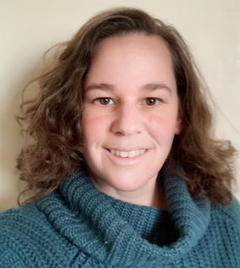


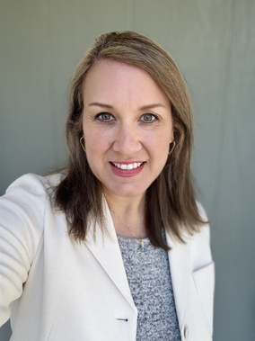

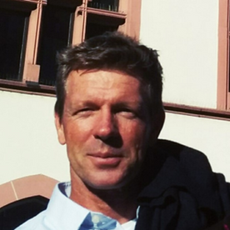

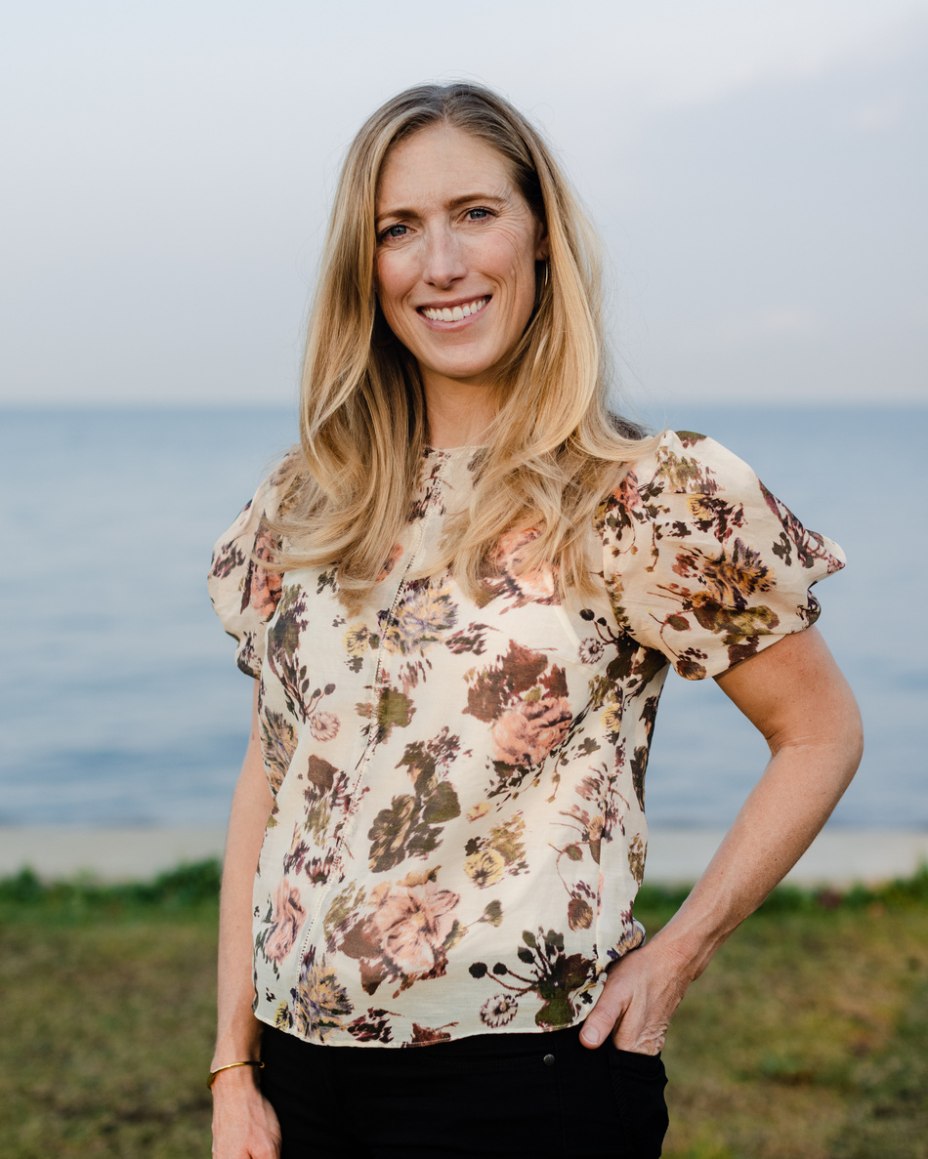
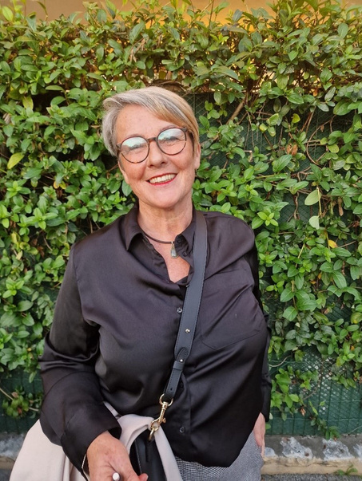
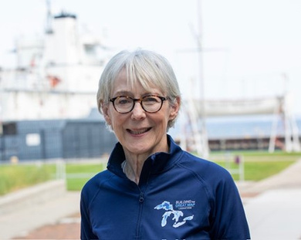
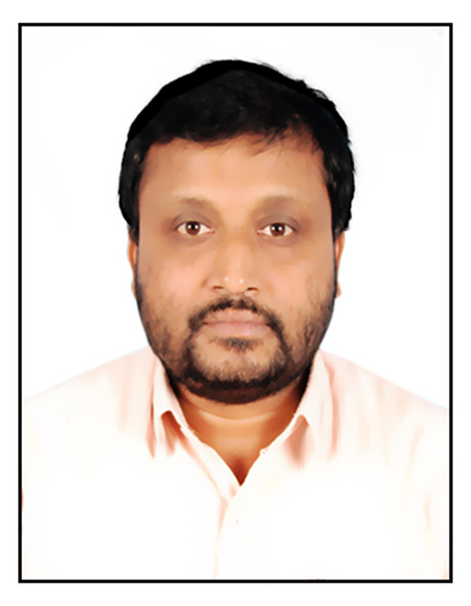
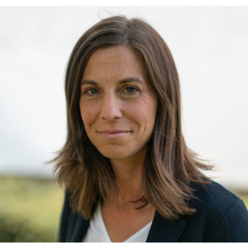
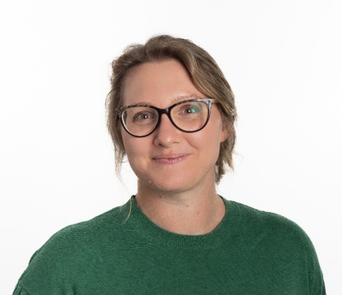
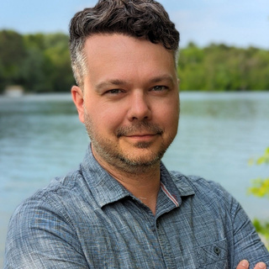
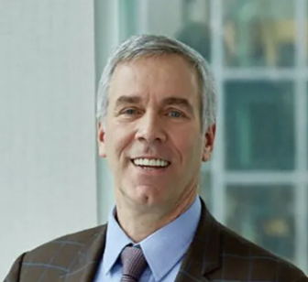

External Advisory Team
Alfredo Giron Nava, Ph.D.
Anuscheh Nawaz, Ph.D.
Aspasia Pastra
Brad deyoung
Carlo Angeles
Christopher Whitt
Corinne Bassin
David P. Keller, Ph.D.
Head of Ocean, World Economic Forum | Head of Friends of Ocean Action
Principal Research Scientist/Engineer, Affiliate Assistant Professor Mechanical Engineering, University of Washington - Applied Physics Laboratory
Assistant Professor, Global Ocean Institute of the World Maritime University, Sweden
Executive Director CIOOS Pacific University of Victoria Professor Emeritus Bartlett Professor of Oceanography Memorial University
Executive Director | The Amazon Pledge
Senior Engineering and Safety Consultant | Lloyd's Register Foundation
Head of Data Solutions | Schmidt Ocean Institute
Director of Research and Technology | Carbon to Sea Initiative
Isa Olalekan Elegbede, Ph.D.
Holly Woytak
Somorin Ifeoluwa Abolade
Jochen Klinke, Ph.D.
Dr. Karim Hilmi
Kate Danaher
Michele Barbier, Ph.D.
Millicent (Milli) Pitts
Head of Research and Innovation @ Saeio Global, Fellow of the Future Earth Coasts (FEC), Deputy Chair, IUCN CEESP Governance, Equity and Rights Theme
Business Development | GIS Analyst | Fugro USA Marine, Inc.
Maritime Lawyer and Ocean Governance Expert
Director of Science at Sea-Bird Scientific
National. Institute of Fisheries Research (INRH-Casablanca) Morocco
Managing Director | Oceans Investment Team | S2G Ventures
Inria Center of Université Côte d’Azur, Ethics Advisor of EU funded projects
Executive Director | Ocean Exchange
Nair Balakrishnan (Bala), Ph.D.
Nele Dageförde
Ruth Patterson, Ph.D.
Scott Loranger, Ph.D.
Ted Janulis
Todd Kleperis
Group Director and Scientist, INCOIS, India
CEO | TransMarTech (TMT)
Adjunct Research Fellow, Charles Darwin University Environmental Services Business Unit Lead, Oceanographer
Acoustician and Applications Scientist - Kongsberg Discovery - Ocean Science
Founder & Principal | Investable Oceans
Founder | Tekmara

Slide 7
Growing Economic Opportunity in the Ocean
Global Blue Economy is growing, and value is expected to double by 2030; USD 3 trillion – OECD
Data and Information is of growing importance, driving a growing need for ocean observations
Sectors include traditional (shipping) and emerging (tourism and aquaculture)
Ocean Observing, products and services not identified as a distinct market sector that attracts investment.
$1.1
BILLION CAD
Canadian Ocean Enterprise Revenue (estimated)
2024 COVE White Paper
$8
BILLION USD
U.S. Ocean Enterprise Revenue (estimated)
2020 IOOS Ocean Enterprise Study
£1.95
BILLION GBP
U.K. Ocean Enterprise Revenue (estimated)
2021 U.K. Marine Scientific Industry
Impact Value of Ocean Enterprise Industry Annual Revenues

Slide 8
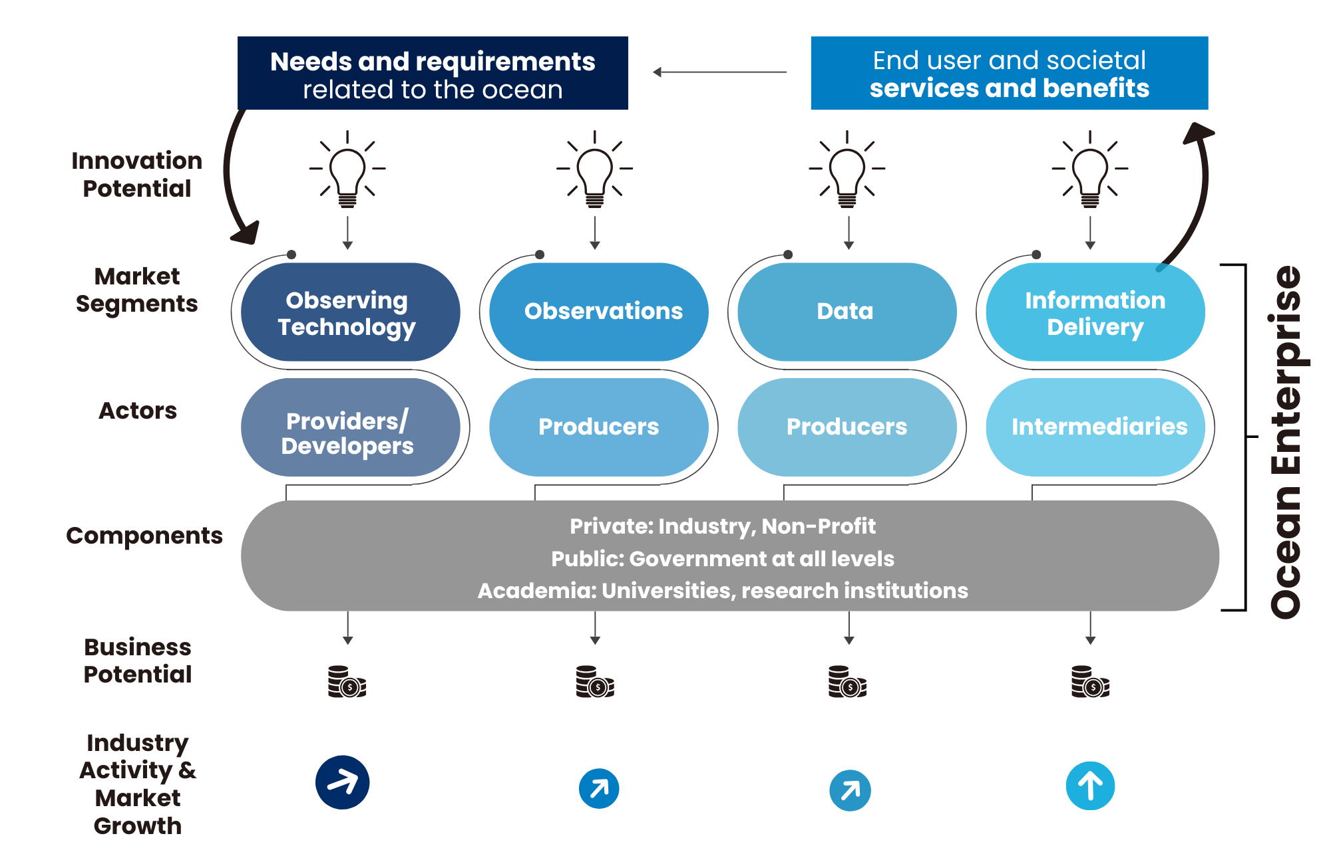
Ocean Observing Value Chain
Ocean Enterprise – actors and functions across the value chain (Background Paper)
1st Dialogues tracked the value chain across 4 different convenings -> Reports
Explored opportunities and barriers - government, industry, and science
Benefits of a mature Ocean Enterprise
Structured and actionable output: Roadmap
Graphic from Dialogues with Industry Roadmap

Slide 9
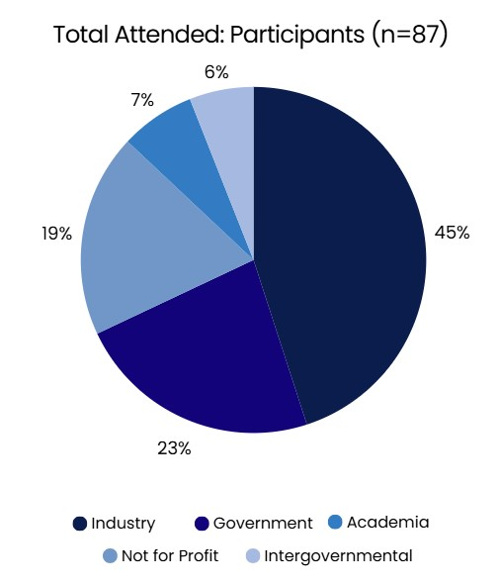
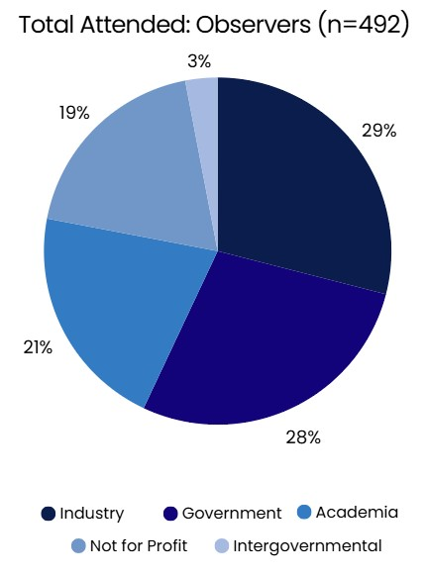
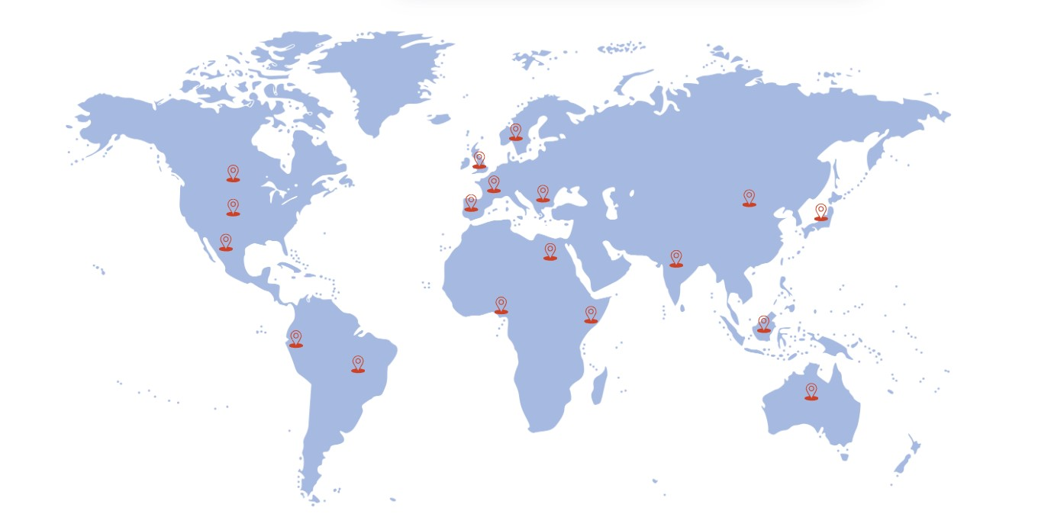
Participant Demographics - Dialogues with Industry
Inaugural Dialogues Series 2022-2023

Slide 10



Foundational Drivers
A Robust Ocean Enterprise that is:
Essential Service
Visible Enterprise
Distinct Market
A robust Ocean Enterprise recognized as essential to lives and livelihoods; ocean knowledge, products, and services are no longer considered peripheral.
The Ocean Enterprise is visible, identifiable, and recognized as a strong contributor to the global Gross Domestic Product (GDP).
The ocean observing products and services sector is identified as a distinct market sector that attracts investment.

Slide 11

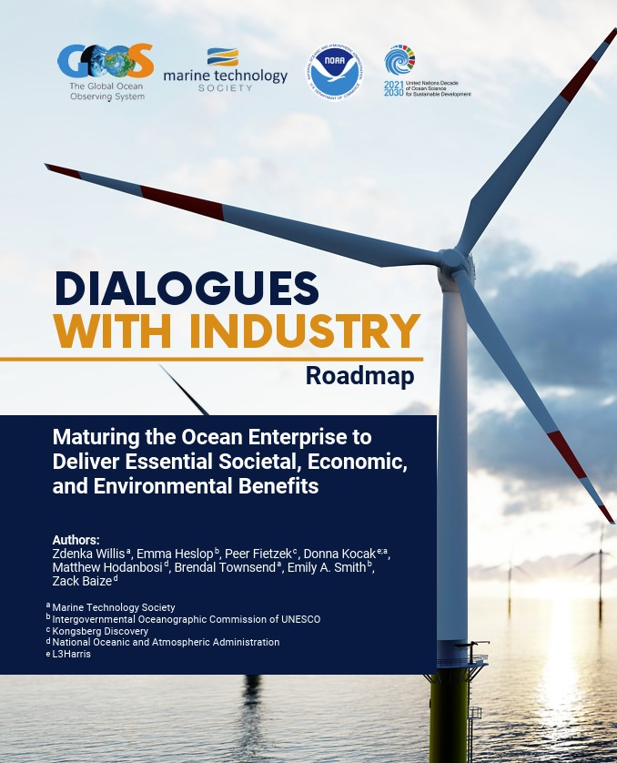
Dialogues with Industry
Inaugural Dialogues Series 2022-2023
Key Takeaways
Ocean observing and services not seen as an independent market
Articulating market size will help drive investment
Aggregation od demand a barrier to Ocean Enterprise
Ocean observing can de-risk blue investment
Perception change needed from being peripheral to essential
Data as a service – a paradigm shift
Read the Full Roadmap

Slide 12
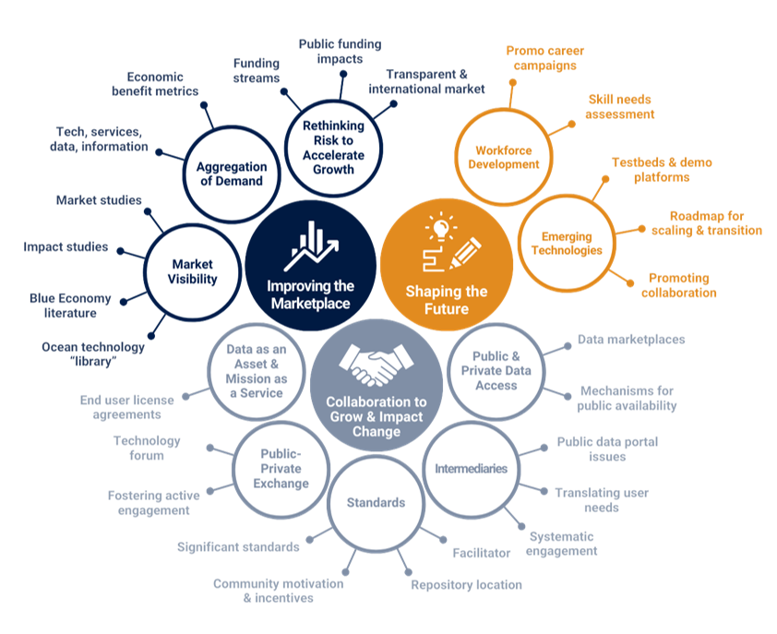
Dialogues With Industry
Roadmap Structure
26 High Priority Action Pathways
Addressing 10 Challenges
Focused on 3 Priority Areas

Slide 13
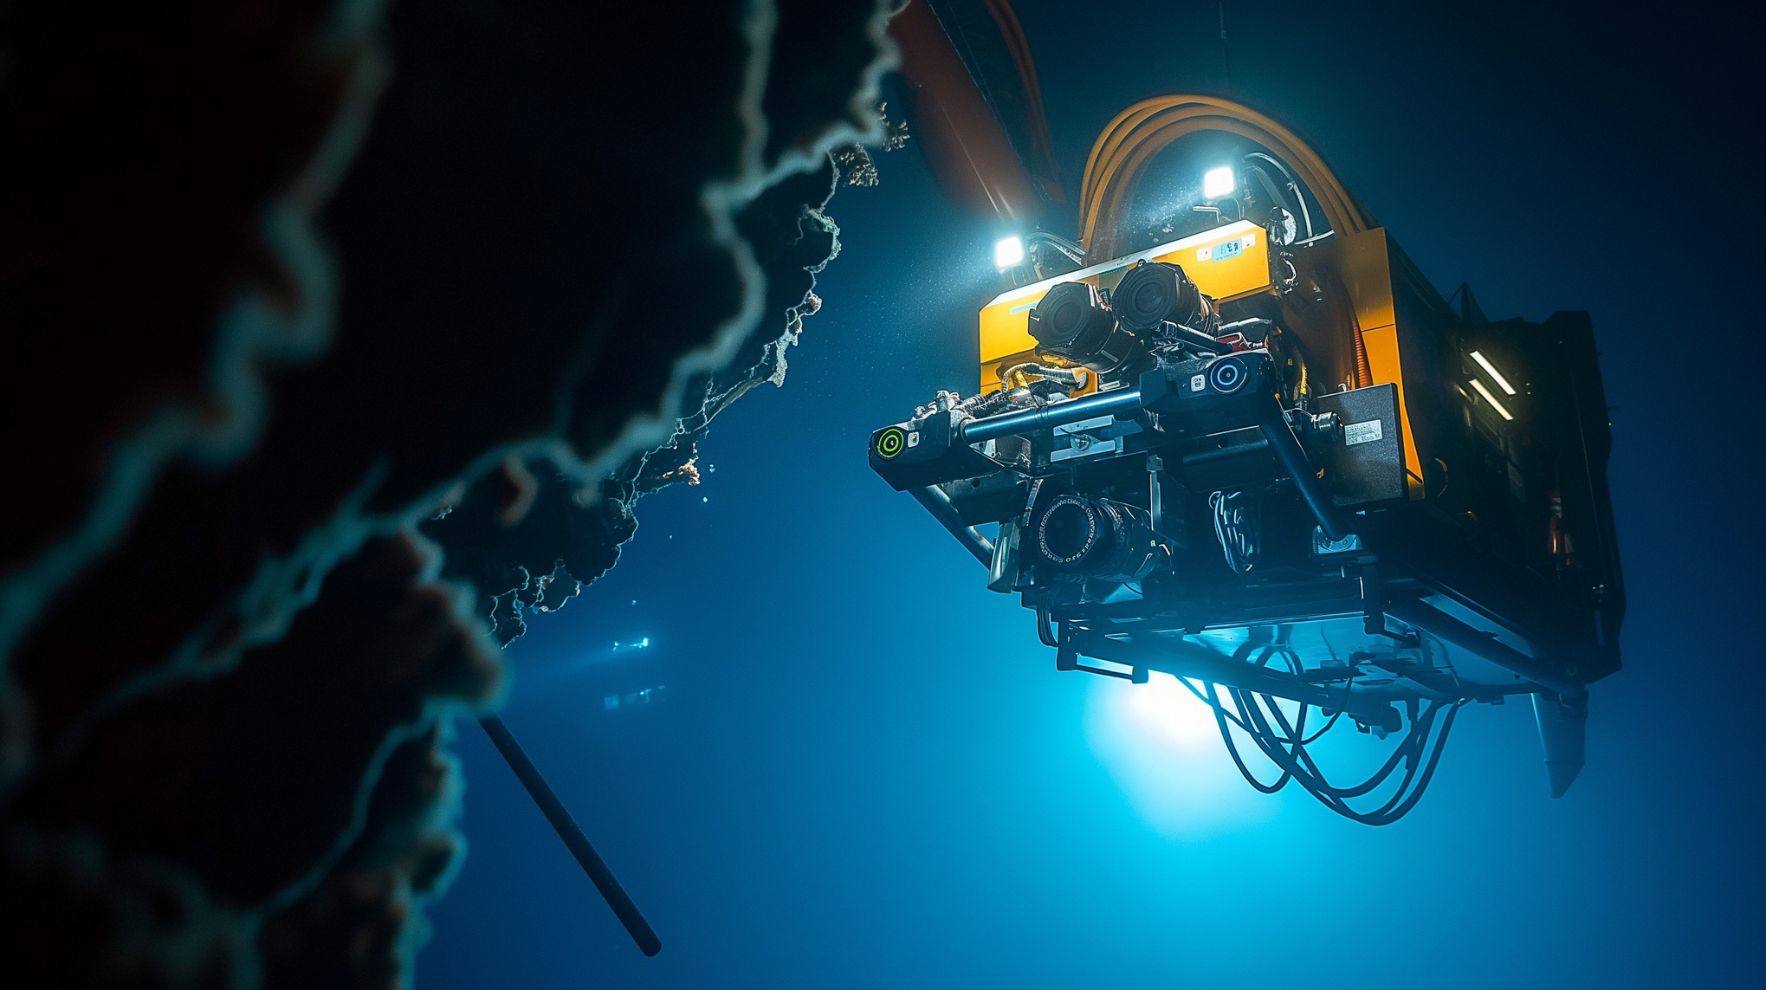





Maturation Benefits
Blue workforce growth from technician to engineers and scientists.
Increased manufacturing supporting new technology development.
Increased private investment and new business development.
Dual use of observing data for defense/commercial and public consumption.
Ocean observing innovation benefits all market segments, and businesses can exploit them commercially.

Slide 14
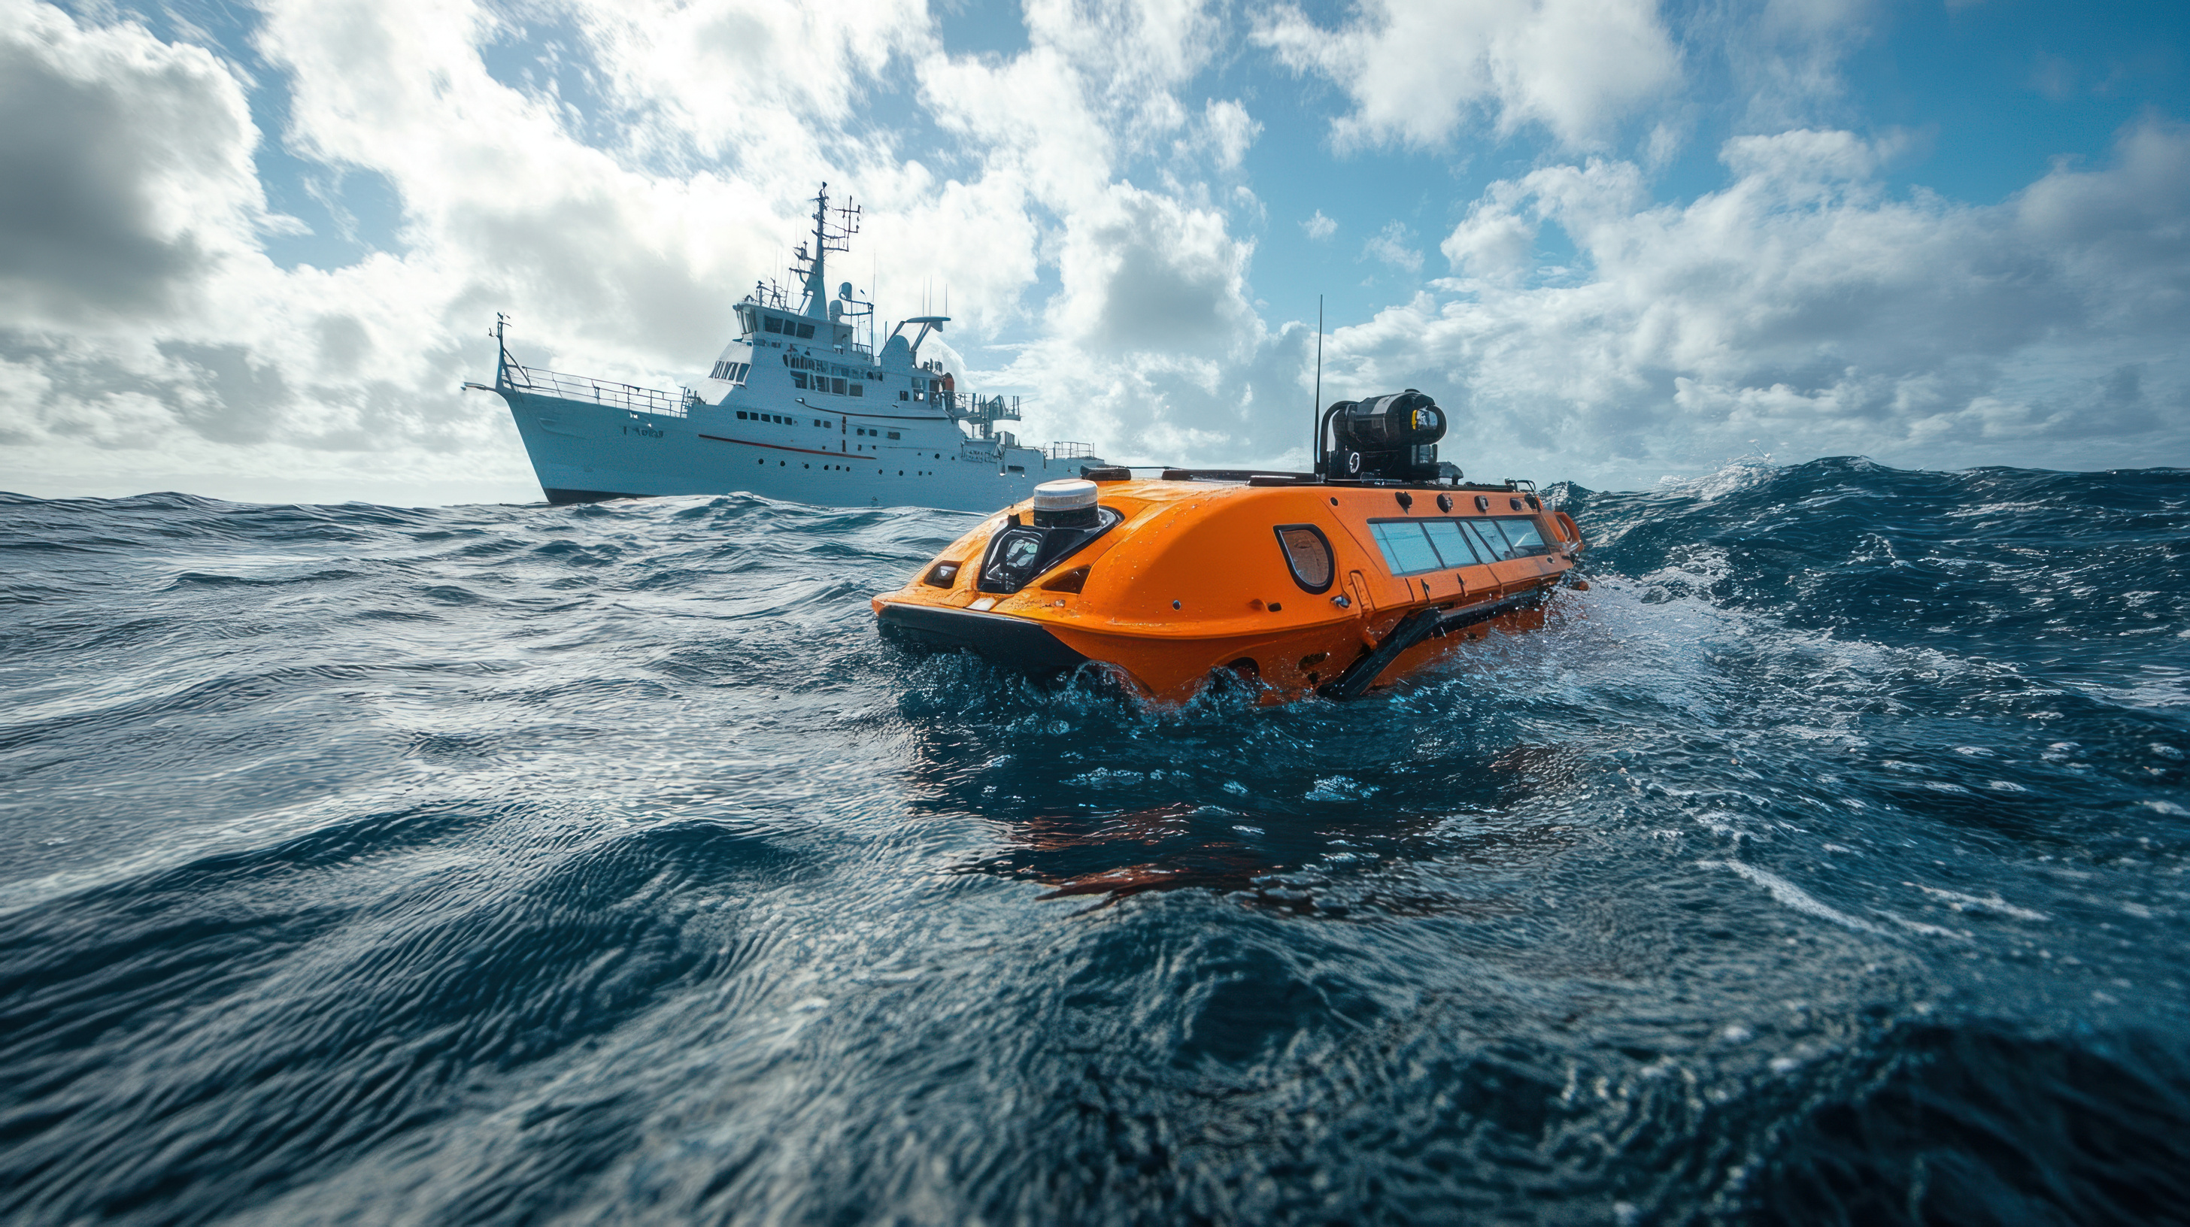
+
+
+
+
+
Grow a vibrant Ocean Enterprise business cluster.
Sustain a robust ocean observing system.
Support NOAA’s Ocean Enterprise Accelerator Program and companion efforts globally.
Improve market visibility and aggregation of demand.
Support recruitment and training of the next generation workforce for the blue economy.
Ocean Enterprise
Initiative
Program Plan

Slide 15
Next Steps
+
Development of the Ocean Enterprise Interchange
+
Ocean Workforce and Microcredential Development Convening
AI driven information portal regarding the overall Ocean Enterprise landscape from the aspects of market reports, industry acceleration, investor relationships, and innovation solutions.
Development of competency-based training supporting up-skilling and re-skilling workforce along with transitioning military personnel from the military to private sector.
+
Ocean Enterprise Business Accelerators Start Up Alley at OCEANS 25 Chicago
+
Dialogues with Industry: Sensing Technology: Future Challenges & Opportunities
Showcase for new business development at the premier North American ocean technology conference.
This signature Ocean Enterprise Initiative effort includes highly facilitated discussion around market dynamics and aggregation, technology needs and development, downstream services, workforce needs, funding mechanism and financial investment strategies.
+
Develop and Advance Global Engagement and Partnerships
Expand collaborations internationally.

Slide 16
Discussion
How well do the OEI ambitions resonate with you?
Which initiatives do you know/are you involved in that have a connection to the OE(I) and that should be connected?
Which options do you see to actively support the OEI from Europe or other parts of the world? Any ideas / suggestions?

Slide 17
Harmful Algae Blooms (HABs)
Dialogues with Industry
Instrument Provisioning
User-Driven Ocean Information
Advancing Control Technologies
Review of Summary & Outcomes

Slide 18
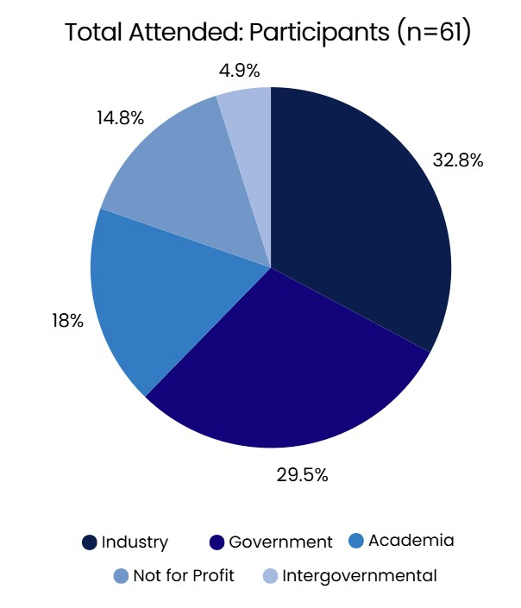
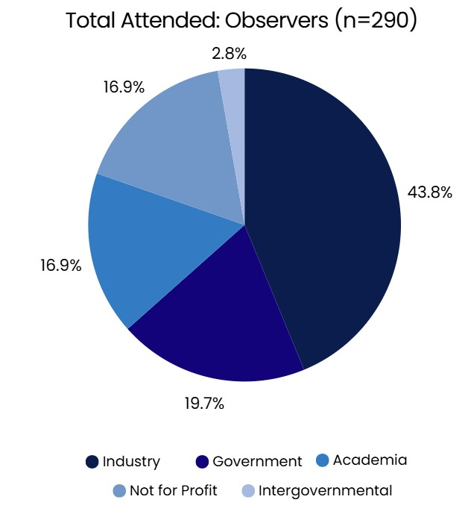
Participant Demographics - Dialogues with Industry
+
Inaugural Event (2022)
+
Harmful Algae Blooms (HABs)

Slide 19
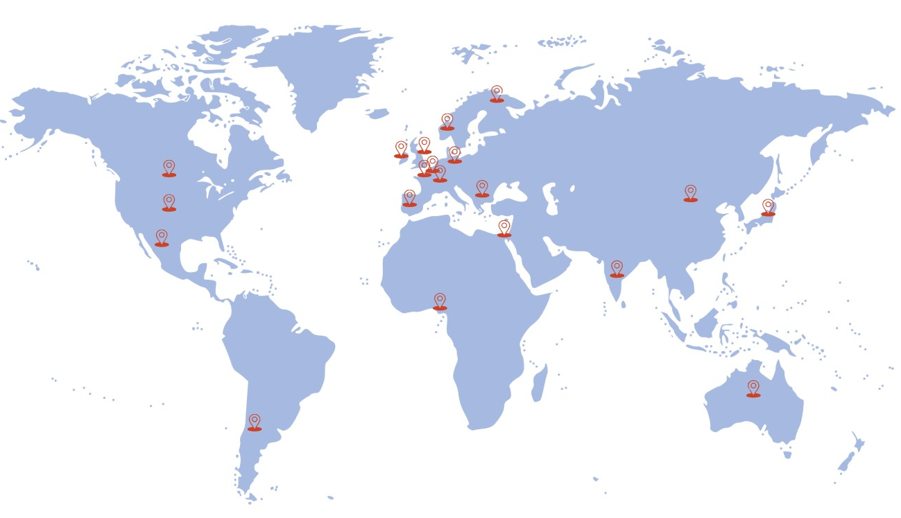
Global Reach - Dialogues with Industry
+
Inaugural Event (2022) – 18 countries
+
Harmful Algae Blooms (HABs) – 21 countries

Slide 20
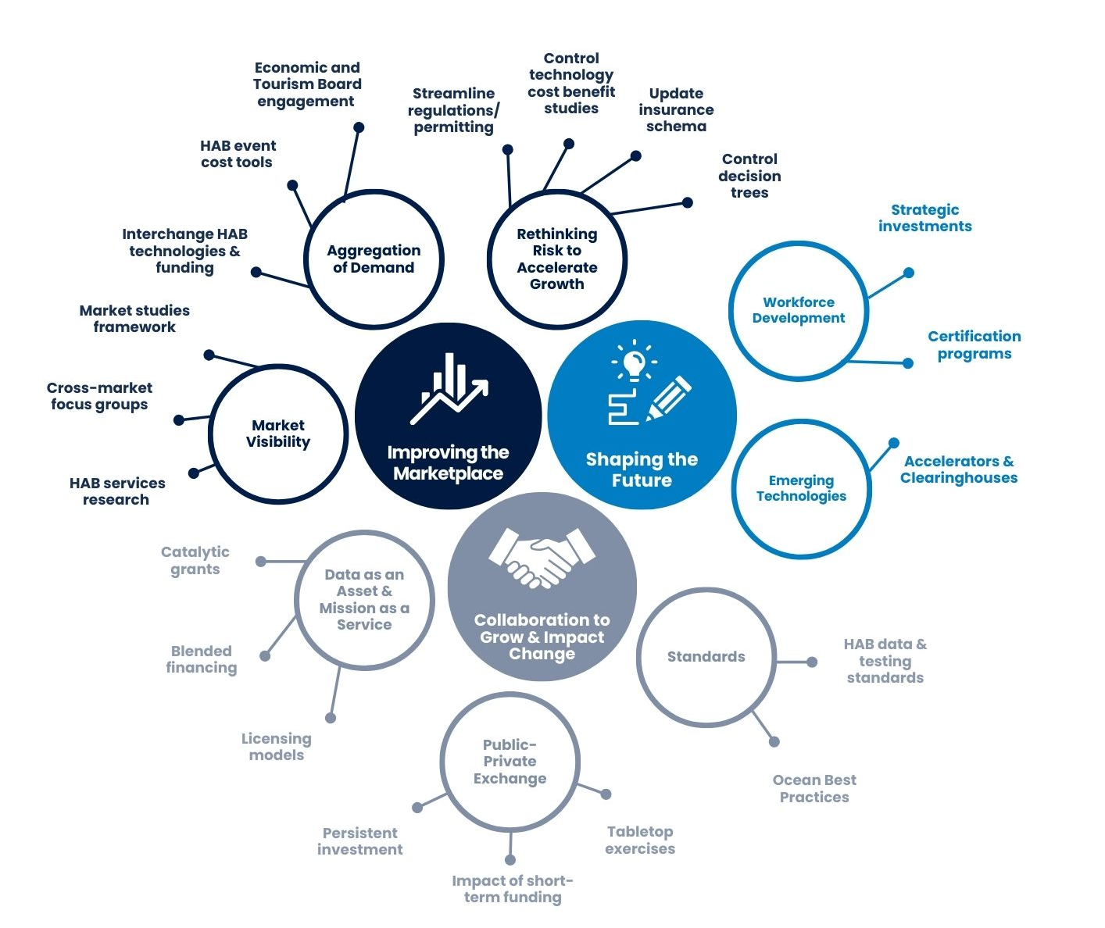
Dialogues With Industry
Roadmap Structure – Harmful Algal Blooms
21 High Priority Action Pathways
Addressing 8 Challenges
Focused on 3 Priority Areas

Slide 21

Priority Area – Improving the Marketplace
HABs Challenges
Key Take Aways and Actions
The full size of the HABs market is currently unknown
Disparity in market size and diversification
Market Analysis and sharing of technological innovations
Government has a key role in setting requirements
Disconnect between the drivers and push for implementation
“Mainstreaming” HABs into environmental monitoring
Permitting is an obstacle
Insurance industry lags introduction of control methods
Disaggregation of regulatory demand is impeding scale up
Development agencies, tourism boards, etc. can influence control methodology acceptance
Education and outreach for control methodologies needed to change perception
Market Visibility
Aggregation of Demand
Rethinking Risk to Accelerate Growth

Slide 22
Priority Area – Collaboration to Grow and Impact Change
HABs Challenges
Key Take Aways and Actions
Data as an Asset and Mission as a Service
Public/Private Exchange
Standards
Startups can create new business and licensing models
New market models can create demand
Advancing operational HAB observing systems will accelerate research and unlock new opportunities for industry and public-private partnerships
Sustainable investment in operational HAB observing systems will benefit impacted industries
Government has a key role in setting data standards
Establishment of standards is crucial to transform data into user-friendly services

Slide 23
Priority Area – Shaping the Future
HABs Challenges
Key Take Aways and Actions
Workforce Development
Emerging Technologies
Workforce shift between specialist and generalist expertise
Sensor Technologies that can be tuned

Slide 24
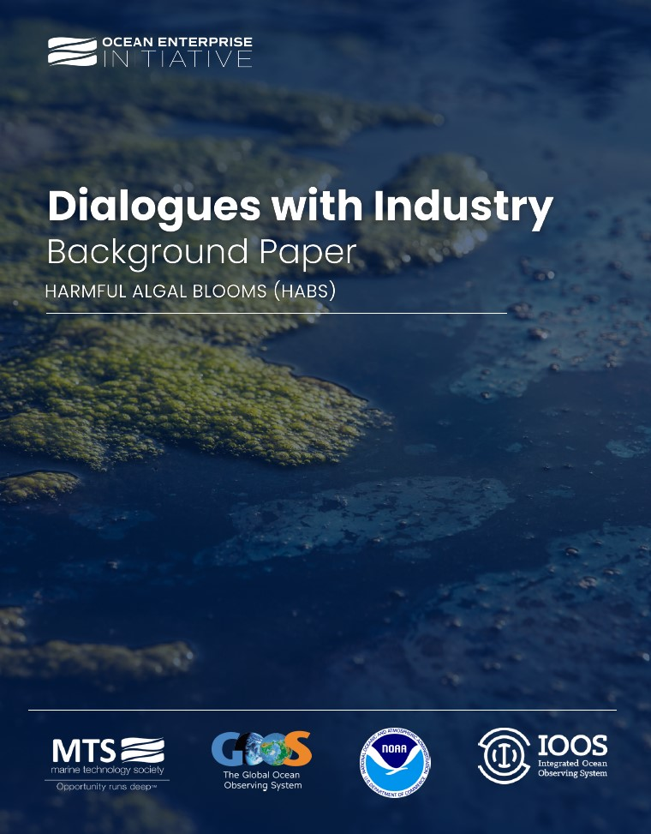

Dialogues with Industry
HABs Background Paper
Read the Full Background Paper

Slide 25
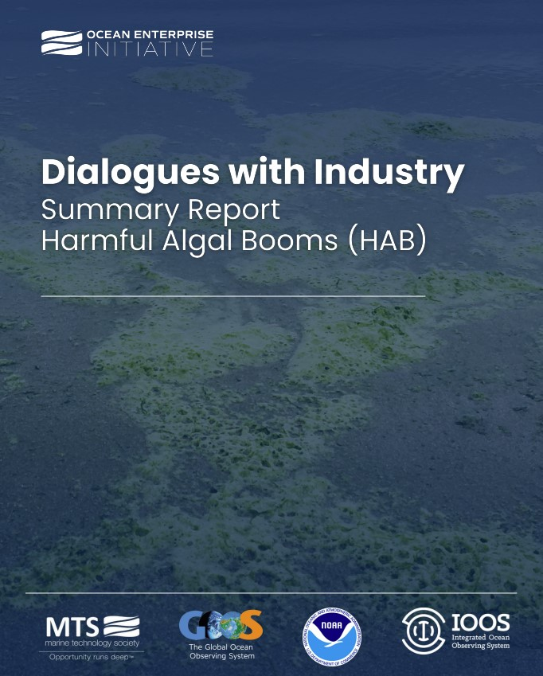

Dialogues with Industry
HABs Summary Report
Read the Full Summary Report

Slide 26
Sensing Technology: Future Challenges & Opportunities
Dialogues with Industry
Upcoming Dialogues – Planning & Participation

Slide 27
Topic Overview: Why it’s Important
Accessible Solutions
Economies of scale are driving down the cost of smart sensor technology, making it more accessible to governments, researchers, and private industries.
Increased Data Value
Enhanced data processing and cloud-based systems allow for better management and integration of vast amounts of sensor-generated data, reducing bottlenecks in analysis and decision-making.
Future Workforce
The rapid evolution of ocean sensing technology is creating demand for specialized skills in data science, robotics, engineering, and marine research.
Advancing Innovation
Emerging IoT-enabled technologies allow for more autonomous and adaptative monitoring systems, reducing reliance on manual observation.

Slide 28
Pre-Dialogue Planning
Pre-Dialogue
(3 months prior)
A global planning team is formed with partner programs.
Pre-Dialogue
(2 weeks prior)
Invited Participants review Case Studies and identify priorities and gaps.
During the Dialogue
Partner programs support as Participants / Observers to address the Background Paper and Use Case studies.
A Background Paper is developed outlining the topic, use cases, and questions.
Participants are identified and invited.
Partner programs share marketing materials with their audience.
Late 2025
3 Dialogues, 2.5-hour sessions
Spaced 1 month apart

Slide 29
Pre-Dialogue Planning
Dialogues with Industry Series
Planning Team Organization
Topic Development Process
Panelist Selection
Late 2025
3 Dialogues, 2.5-hour sessions
Spaced 1 month apart

Slide 30

Interested?
Get Involved!
Check out our LinkTree
+ Email
+ Website
+ Publications (HABs Reports & More)
+LinkedIn Page
+HABs YouTube Playlist

